Slide 1
Dangers Of IoT Devices
Notes:
What does the s stand for in IoT, Security

Slide 2
Agenda
Who am I
What is IoT
What dangers does it pose
What can you do

Slide 3
Jokes
What does the S stands for in IoT?
Why did the dad connect his lawn mower to Wi-Fi?
Notes:
Security
So, he could finally say, “I’m cutting-edge”
My dad when he was studying for the cissp he found the frsecure class online and liked the dad joke that broke down security. While my introduction and sister companies us in due to dad jokes for that I have two jokes

Slide 4
Who am i
Stephen Glombicki
High School Senior
Purdue 29’ Computer Engineering
CvCISO, OSCP, CCNA, CRTO, CRTL
Notes:
Talk about open to internships
Joke about how there is 21 days left of school and that I am not counting

Slide 5
CvCiso Community
Notes:
I just want to take a moment to thank the meg and community for allowing me the opportunity to speak here today. I took the CvCISO level one course 2 years ago and was treated and welcomed warmly. One big thing I learned from that was the security is good as your network.
2 years ago when I was 16 years, even though I was 16 years old I was treated as an equal among my classmates. One of the things I learned was the strength and depth of the cyber dependends on the speed and reslicenay at the cyber that commonlyso with that it is my pleasure to speak to you feel free to to reach out to me about anything in as we are all engaged in protectiong civilization. I alogn don’t know everything but together as a community we know everything. I will esppicay like to thank meg for allowing me to pseak and for her contuned kindness and support
Two years ago, when I was just 16, I was fortunate to be treated as an equal among my peers—an experience that shaped how I see this community. One of the key lessons I took away is that the strength and depth of cybersecurity depend not only on technical skill, but also on the speed and resilience with which we respond to threats.
With that in mind, it’s truly a pleasure to speak with you today. Please don’t hesitate to reach out—whether for questions, discussion, or collaboration. We’re all in this together, working to protect the foundations of our digital civilization.
I don’t have all the answers, but I believe that as a community, we do.
A special thank you to Meg for giving me the opportunity to speak, and for her ongoing kindness and support.

Slide 6
History of IOT

Slide 7
Overview of History
1982 – First “smart” device: a Coke machine that reported inventory
1999 – Term "Internet of Things" coined
2010s – Explosion of smart devices (homes, wearables, industry)
2018 – IoMT term become popular

Slide 8
What is IoT?

Slide 9
IoT?
Internet of things (IoT)
Industrial Internet of Things (IIoT)
Internet of Medical Things (IoMT)
Notes:
How I am grouping IoT
IIoT makes up 11%
IoMT makes up 8%

Slide 10
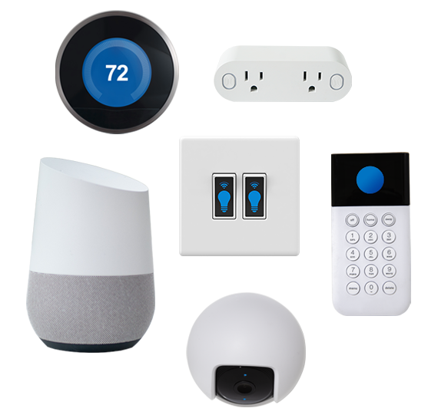
What are Iot Devices
Physical devices that connect to the internet
Examples
TVs
Security Cameras
Smart Plugs
Notes:
Show them that there are a bunch of generic iot devices

Slide 11
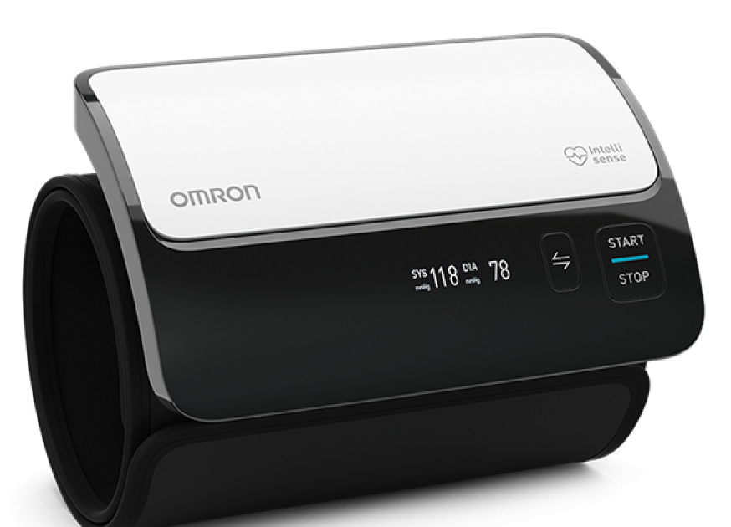
What are some IoMt Devices
Notes:
Medical deal with real lives
Give doctors real time access to patients

Slide 12
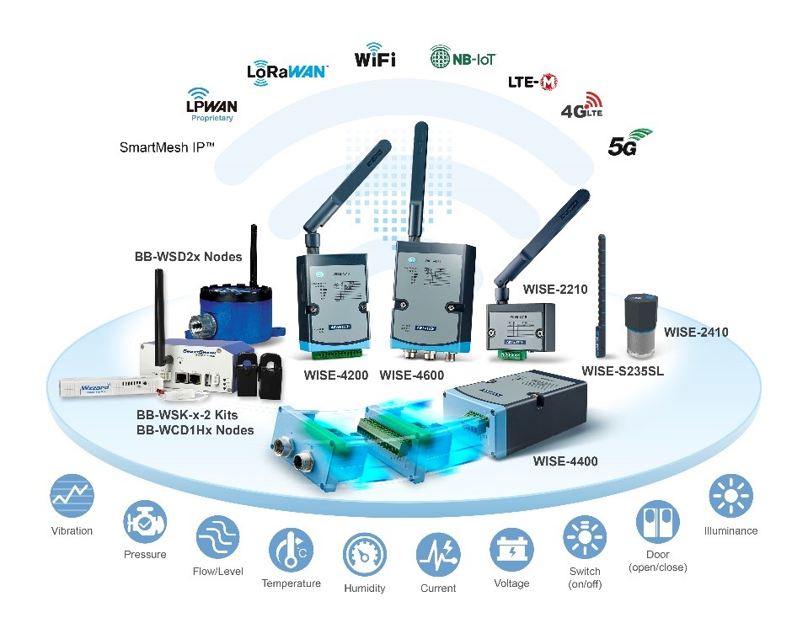
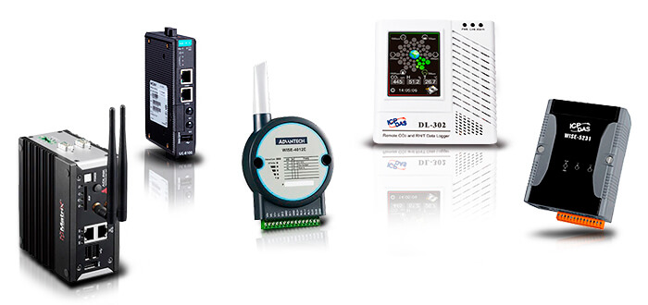
What are some IIot Devices
Notes:
We have air quality, pump monitors, gas monitors. In addition the industrial grade wireless communication protocol

Slide 13
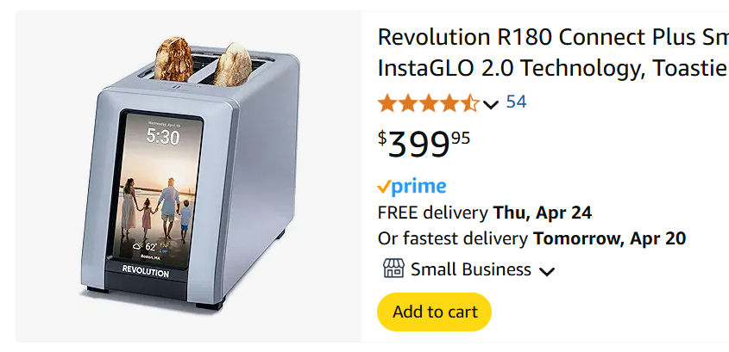
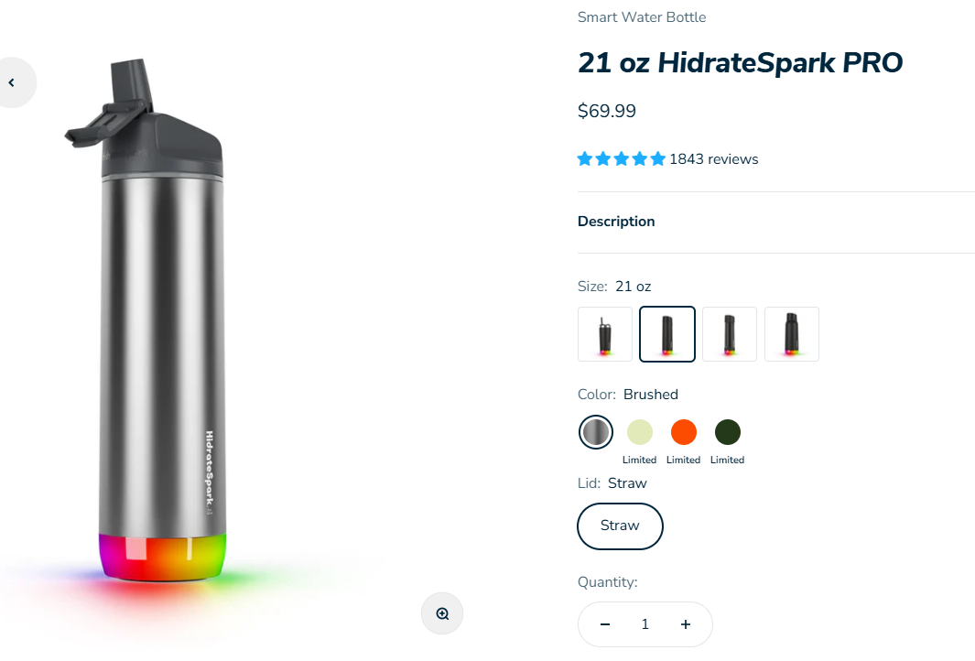
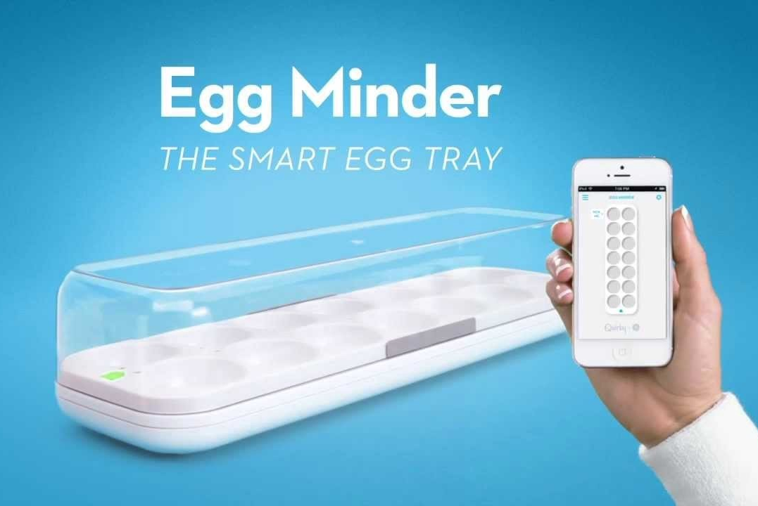
What are some Iot Devices
Notes:
These are silly things, but they expand the attack surface!

Slide 14
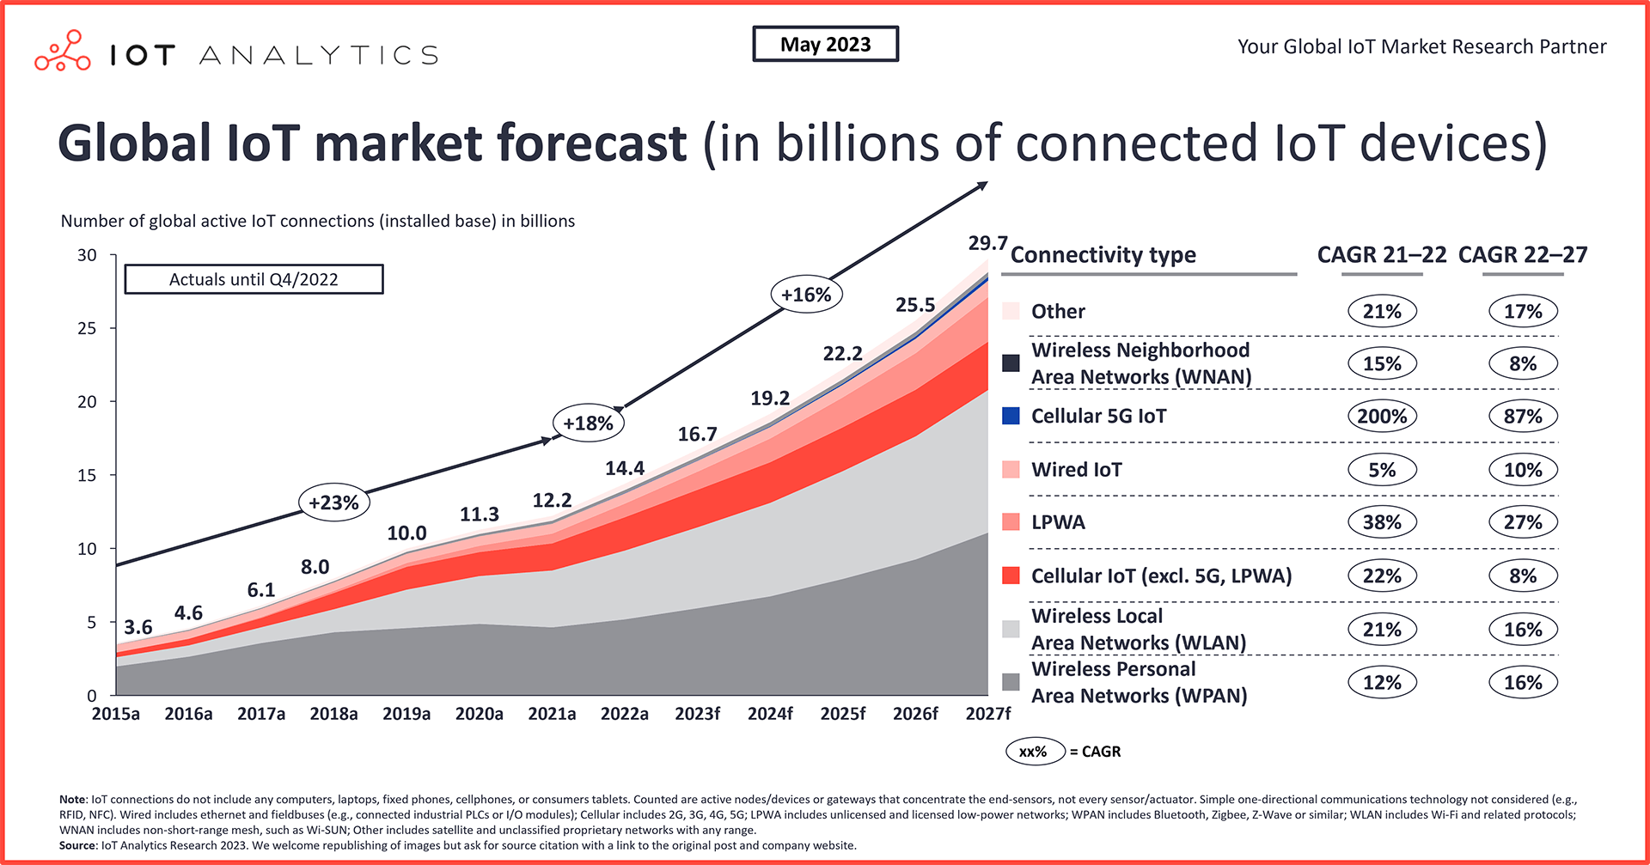
IOT IS increasing
Notes:
79 zetabytes of data in a year ( need to relate )
2 hour movie is 5gb and 79 zeta byes is 15.8 trillion movies
How many devices per people
How many people have access to internet

Slide 15
Benefit of IoT
Automation and control
Access information in real time
New business opportunities
Improve monitoring with sensors
Machine-to-machine communication
Better quality of life
Cost reduction
Increased efficiency and productivity
Predictive analytics
Remote health monitoring
Notes:
As connectivity grew, so did the attack surface.

Slide 16
Access information in real time
Doctors know how patients are doing
Large warehouse tracking
Refrigeration monitoring
Notes:
As connectivity grew, so did the attack surface.

Slide 17
Cost Reduction
Can save 20% on heating of small offices
Power savings on lighting of 30%
Saves healthcare companies $100 billion a year
Optimize maintenance for equipment
No going back! IoT is part of ecosystem. Cost savings are tangible.
Notes:
As connectivity grew, so did the attack surface.

Slide 18
IoT Security Problem
Attack surface is growing every year.
Devices are easy to find
Devices are insecure
What do you as a security professional do?
Notes:
As connectivity grew, so did the attack surface.

Slide 19
Past Incidents

Slide 20
Past Event: Miria Botnet
What Happened: A massive DDoS attack used hundreds of thousands of IoT devices (cameras, routers) to take down websites like Twitter, Netflix, and Reddit.
Why It Worked: Devices had factory-default credentials.
No user awareness or firmware updates.
Impact: Over 1 Tbps of traffic flooded Dyn DNS servers.
Caused global service disruptions.

Slide 21
Past Event: Target Data Breach (2013)
Initial access gained through HVAC IoT system
Pivoted to Targets internal network
$18.5 million settlement
Target hired Evan Francen for consulting services on the technical aspects of the data breach

Slide 22
Baby Monitors
What Happened: Hackers accessed internet-connected baby monitors to spy on families and even talk to children
Notable Cases:
2013: A Houston couple hears a hacker yelling at their 2-year-old
2018–2020: Multiple reports across the U.S. of strangers speaking through monitors
How?
Weak/default passwords
Unpatched firmware
No two-factor authentication

Slide 23
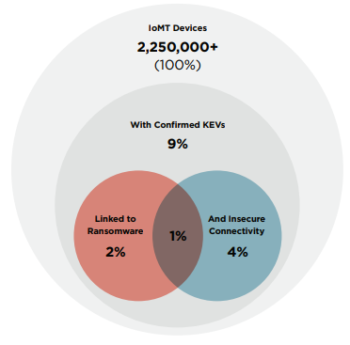
Medical Monitors
Real-World Risks:
2017: FDA recalls 465,000 pacemakers due to hacking risks.
Hospitals targeted via infusion pumps and imaging devices with exposed ports.
Security Challenges:
Long device lifespans = outdated software
Hard to patch or recall safely
Life-or-death stakes if compromised

Slide 24
What dangers Does IOT pose

Slide 25
Dangers of IoT
Key Traits:
Always connected to the internet or local network
Often unmonitored or unmanaged
Typically have weak or outdated security
Impact
No idea what the device is doing
50% of IoT devices has exploits
Unpatched software is responsible for 60% of IoT breaches
Default credentials is still widely used

Slide 26
Shodan & Google Dorks
How to find IoT devices

Slide 27
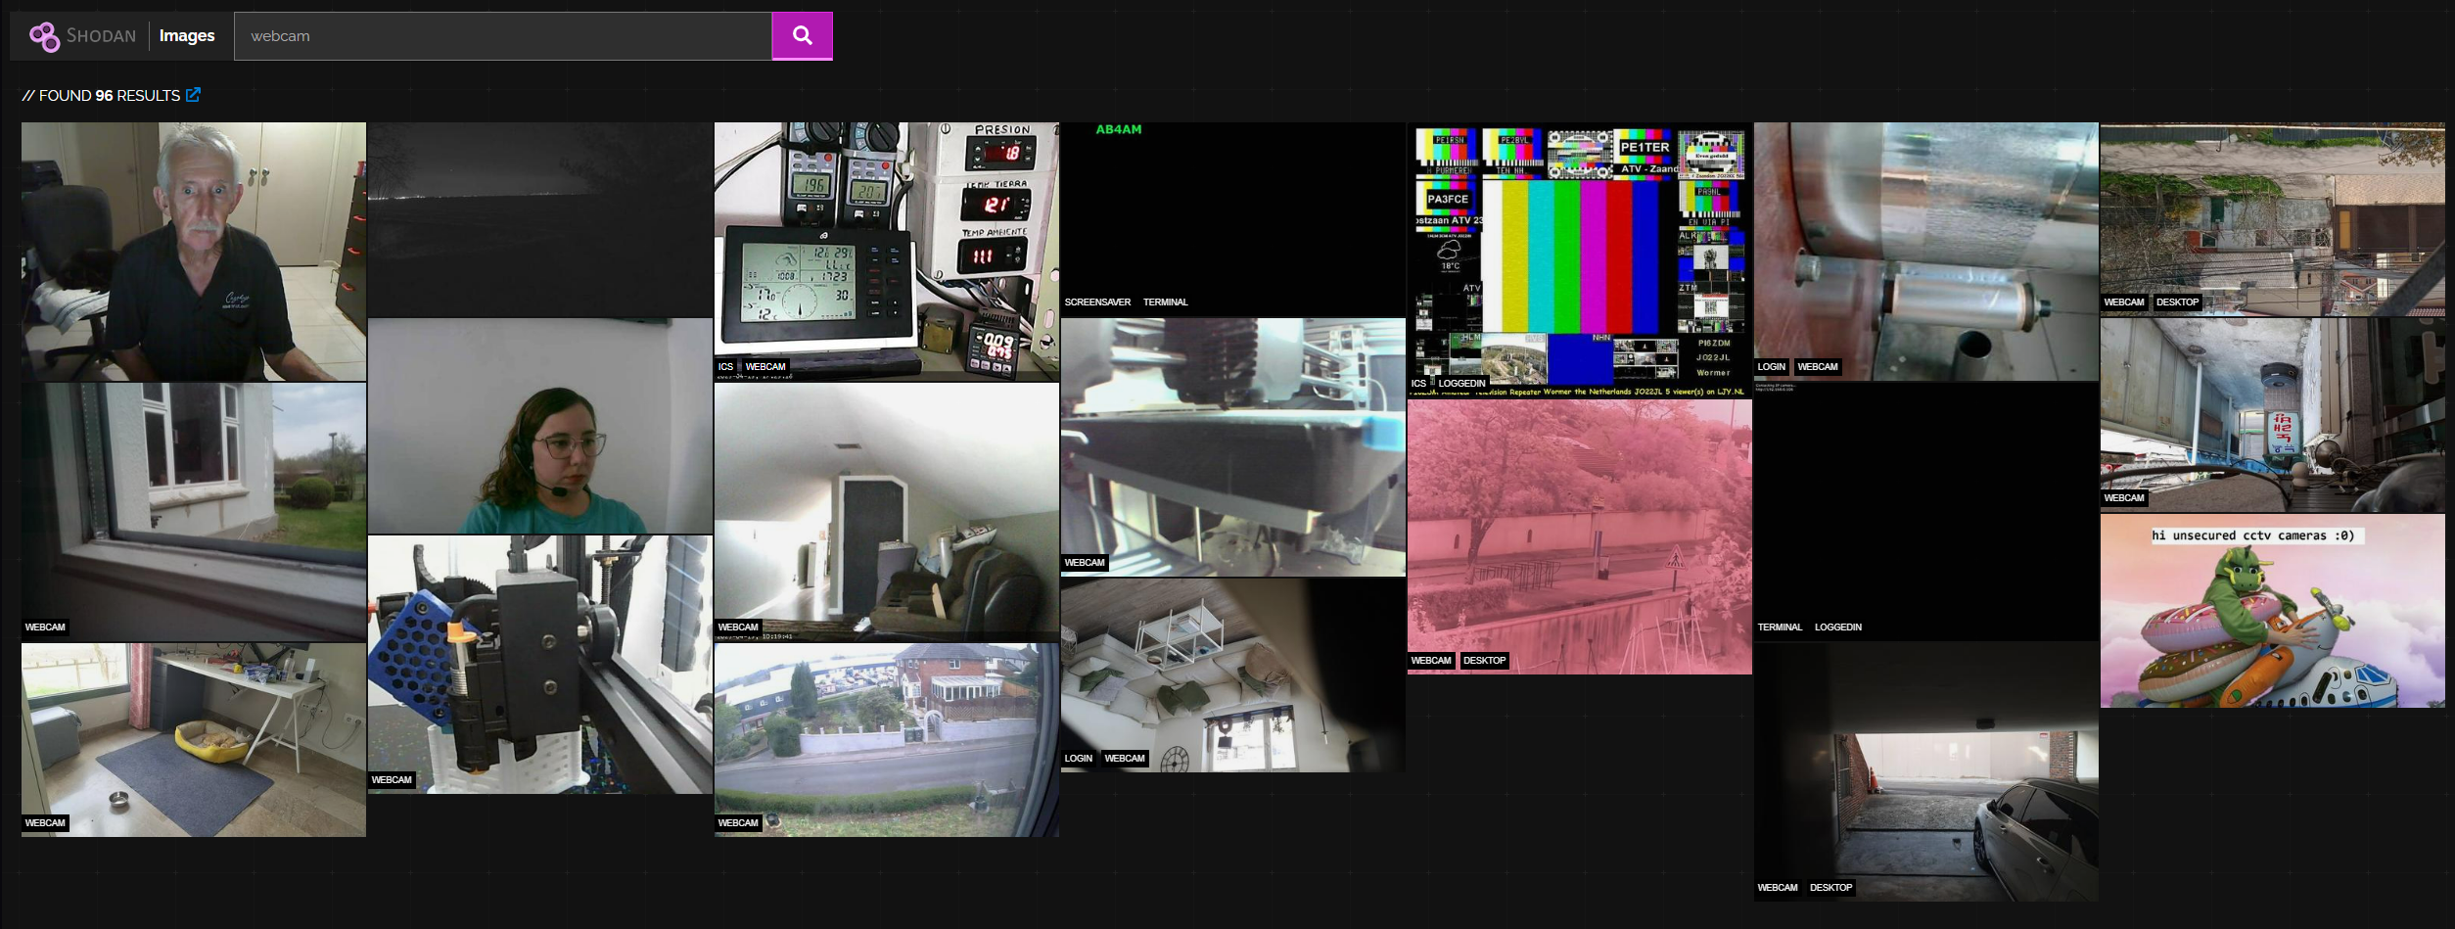
Shodan Images

Slide 28
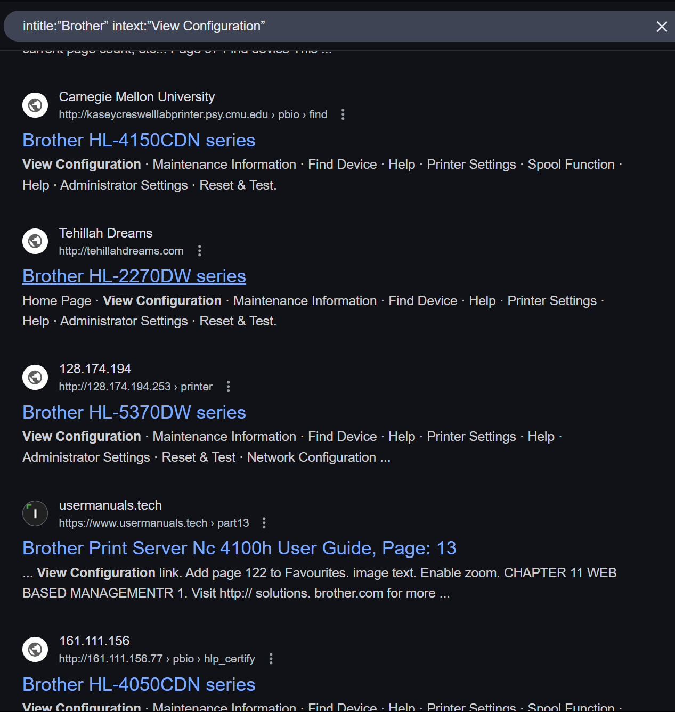
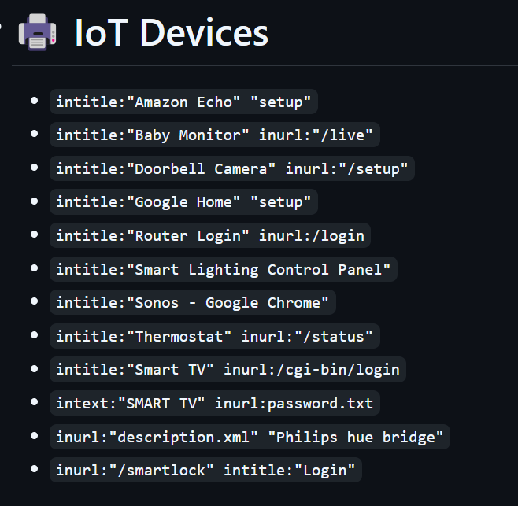
Google Dorks

Slide 29
How do IOT Devices Communicate?
MQTT
Z-Wave
Wi-Fi
Bluetooth
LoRaWAN
Notes:
As connectivity grew, so did the attack surface.

Slide 30
What regulations are in place

Slide 31
Current Regulations
NIS 1 (May 2018) and NIS 2 (Jan 2023) (EU)
GDPR (EU)
Cybersecurity Improvement Act (2020) (US)
California IoT cybersecurity law (Effective Jan 2020)
Notes:
Add years

Slide 32
What you can do

Slide 33
How to protect yourself
Identify what devices you have
Isolate IoT devices to their own separate network
Change default credentials
Enable auto-update

Slide 34
Key Take aways
IoT devices are the way of the future
These devices are made with security as an after thought
Don’t forget about these tiny devices on your network

Slide 35
THANK YOU
Stephen Glombicki
sg@ics.red​
https://blog.ics.red

Slide 36
Navigating Q&A sessions
Know your material in advance​
Anticipate common questions​
Rehearse your responses
Maintaining composure during the Q&A session is essential for projecting confidence and authority. Consider the following tips for staying composed:​
Stay calm​
Actively listen​
Pause and reflect​
Maintain eye contact

Slide 37
Speaking impact​
Your ability to communicate effectively will leave a lasting impact on your audience​
Effectively communicating involves not only delivering a message but also resonating with the experiences, values, and emotions of those listening

Slide 38
Dynamic delivery​
Learn to infuse energy into your delivery to leave a lasting impression​
One of the goals of effective communication is to motivate your audience
Metric​ | Measurement​ | Target​ | Actual​
Audience attendance​ | # of attendees​ | 150​ | 120​
Engagement duration​ | Minutes​ | 60​ | 75​
Q&A interaction​ | # of questions​ | 10​ | 15​
Positive feedback​ | Percentage (%)​ | 90​ | 95​

Slide 39
Speaking engagement metrics​
Impact factor​ | Measurement​ | Target​ | Achieved​
Audience interaction​ | Percentage (%)​ | 85​ | 88​
Knowledge retention​ | Percentage (%)​ | 75​ | 80​
Post-presentation surveys​ | Average rating​ | 4.2​ | 4.5​
Referral rate​ | Percentage (%)​ | 10​ | 12​

